Slide 1
SPHERE-PPL Annual Meeting & Workshop
Environmental Modelling & Forecasting
SPHERE-PPL Team
Wednesday 14th January 2026

Slide 2
Welcome!

Slide 3
Agenda
Timings | Activity | Description
9:30-10:00 | Arrivals & Registration
10:00-10:15 | Introduction from the SPHERE-PPL Team - Will Pearse | Meet the team and an introduction to the vision
10:15-10:40 | Keynote 1 - Julie Smith | ADAS
10:40-11:00 | Keynote 2 - Robin Freeman | ZSL
11:00-11:25 | Coffee Break
11:25-11:35 | Presentation - Rich Wood | Forecasting Severe System Pressure in the NHS
11:35-12:20 | Break-Out Discussion | Activity 1 - Identifying key challenges in environmental science
12:20-12:50 | Break-Out Feedback | 2-minute presentations on challenges
12:50-13:50 | Lunch

Slide 4
Agenda
Timings | Activity | Description
13:50-14:00 | Lyme Disease Contest Prize Giving
14:00-14:10 | Presentation - Will Pearse | Building a Forecasting Contest
14:10-14:45 | Break-Out Design | Activity 2 - Groups design forecasting contests
14:45-15:15 | Break-Out Feedback | Group feedback and discussion of contest priorities
15:15-15:40 | Coffee Break
15:40-16:05 | Keynote 3 - Eric Daub | The Alan Turing Institute
16:05-16:15 | Presentation - Will Pearse | What can SPHERE-PPL do for you?
16:15-16:35 | Break-Out Discussion | Activity 3 - Brainstorming requests for workshops, training and support
16:35-16:55 | Break-Out Feedback | Creating a community priority list
16:55-17:00 | Wrap-Up

Slide 5
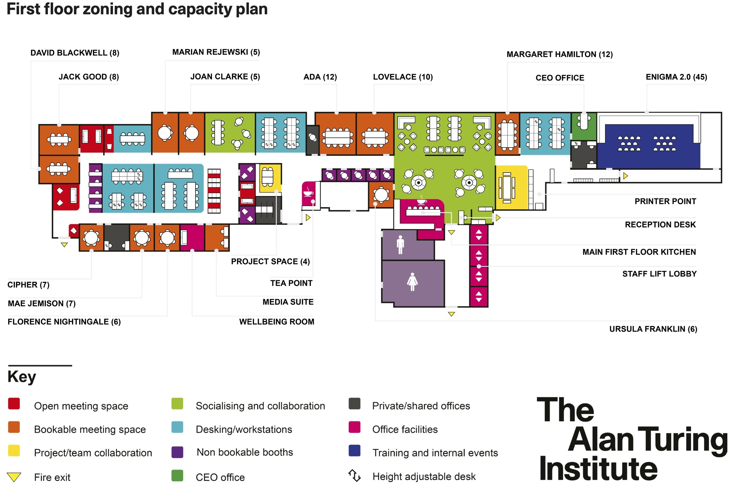
Facilities & Accessibility

Slide 6
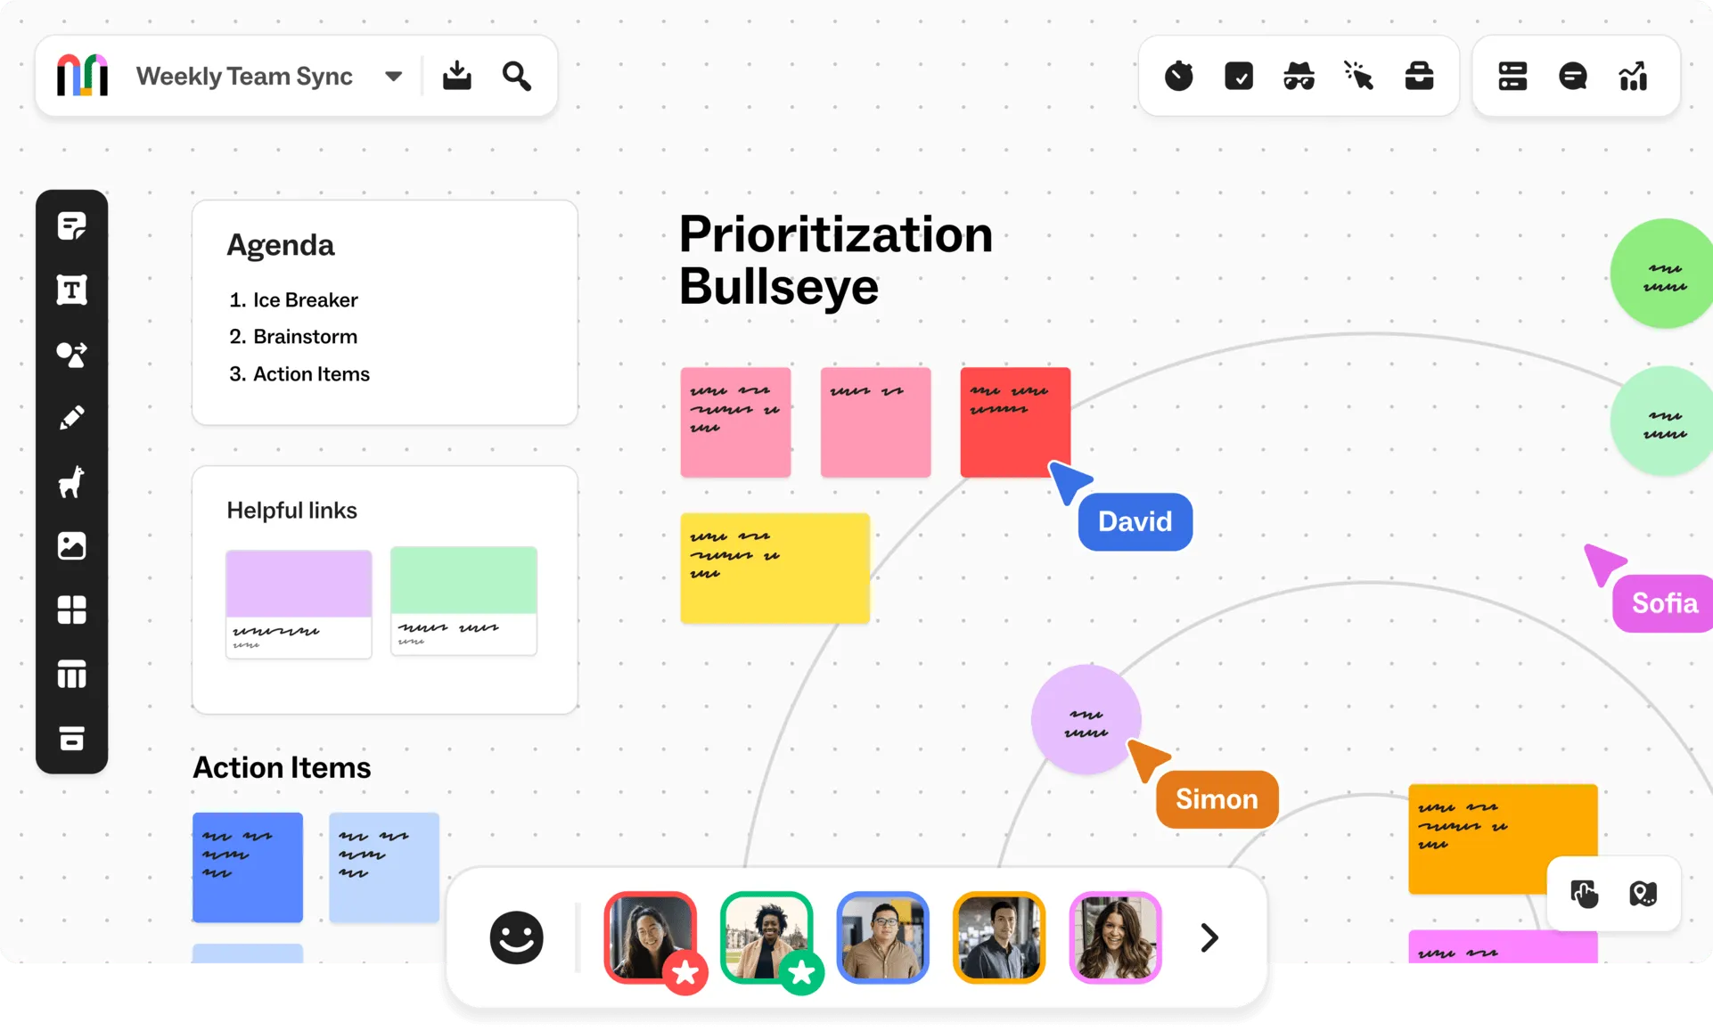
Mural
We will be using Mural for all the activities:
Activity 1: https://shorturl.at/rtEzv
Activity 2: https://shorturl.at/1ahdl
Activity 3: https://shorturl.at/SxCEd

Slide 7
Code of Conduct
Respectful Communication: Communicate with others in a professional and considerate manner. Be mindful of diverse perspectives and experiences. Avoid interrupting others and listen actively.
Inclusive Language: Use inclusive language that avoids any discriminatory or offensive remarks. Be mindful of gender, race, ethnicity, religion, sexual orientation, and other personal attributes.
Active Participation: Engage actively in discussions and activities. Share your insights and perspectives while being mindful of others' contributions.
Professional Conduct: Maintain a professional demeanour throughout the workshop, including during breaks and social events.
Mobile Devices: Minimize distractions by silencing mobile phones or using them only during breaks, unless they are essential for workshop activities.

Slide 8
Introduction from the SPHERE-PPL Team

Slide 9
Outcomes of the Day
This full-day event will bring together experts in a range of fields from industry, academia, and government to discuss cutting-edge research and explore collaborative opportunities within environmental science.
Meeting participants will:
Network with policy specialists and data scientists to discuss issues through a common language
Identify forecasting challenges that the SPHERE-PPL Community will undertake and contribute to the design and outcomes of these endeavours to maximise their impact.
Prioritise the training and support provided by SPHERE-PPL to the community to expedite the development of analytical capabilities where they are most urgently required

Slide 10
Keynotes

Slide 11


Keynotes
 | Julie Smith – ADAS
 | Dr Robin Freeman – ZSL

Slide 12




Defra Survey of Crop Pests and Diseases

Slide 13
Key challenges for arable crop production in UK agriculture
A growing population to feed!
Indigenous invertebrate pests & diseases cause major yield losses
Disease pressure fluctuates from year-to-year but pressure is difficult to predict
Management is largely via fungicides, resistant varieties, good agronomy
Decline in fungicide efficacy and alarming resistance issues
Loss of fungicide actives/products due to regulation
Resistant varieties break quickly as pathogen populations evolve
Move towards regenerative agriculture can favor certain diseases
IPM practices often require more diverse rotations
Changing weather patterns make the season unpredictable
Reduction in cropping area as land is placed into environmental schemes
Increased public scrutiny; carbon footprint, nitrogen and pesticide use
Requirement to “produce more, with less”

Slide 14

















What is the Survey of Crop Pests & Diseases?
Government funded annual survey, running for approx. 55 years
Covers England and Wales
Focuses on winter wheat and winter oilseed rape crops
Monitors endemic diseases and invertebrate pests
Collects accompanying data on agronomic practices
Produces longitudinal, spatially resolved, consistent datasets

Slide 15
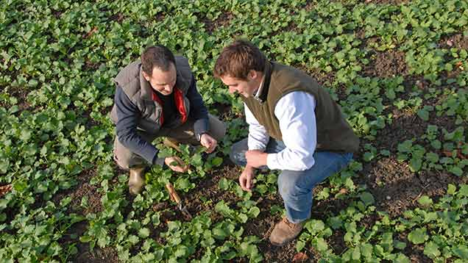



Why is the survey important?
Delivers pest and disease information essential to establishing consensus across key stakeholder groups
Farmers and advisers
Industry
Researchers
Policy makers

Slide 16
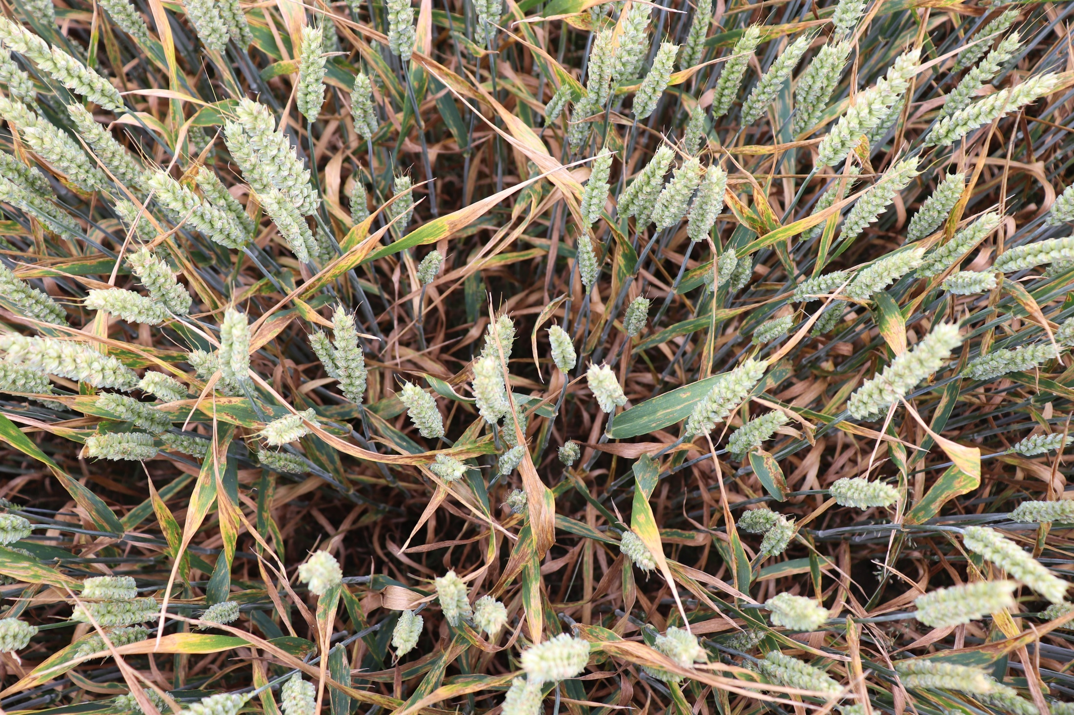
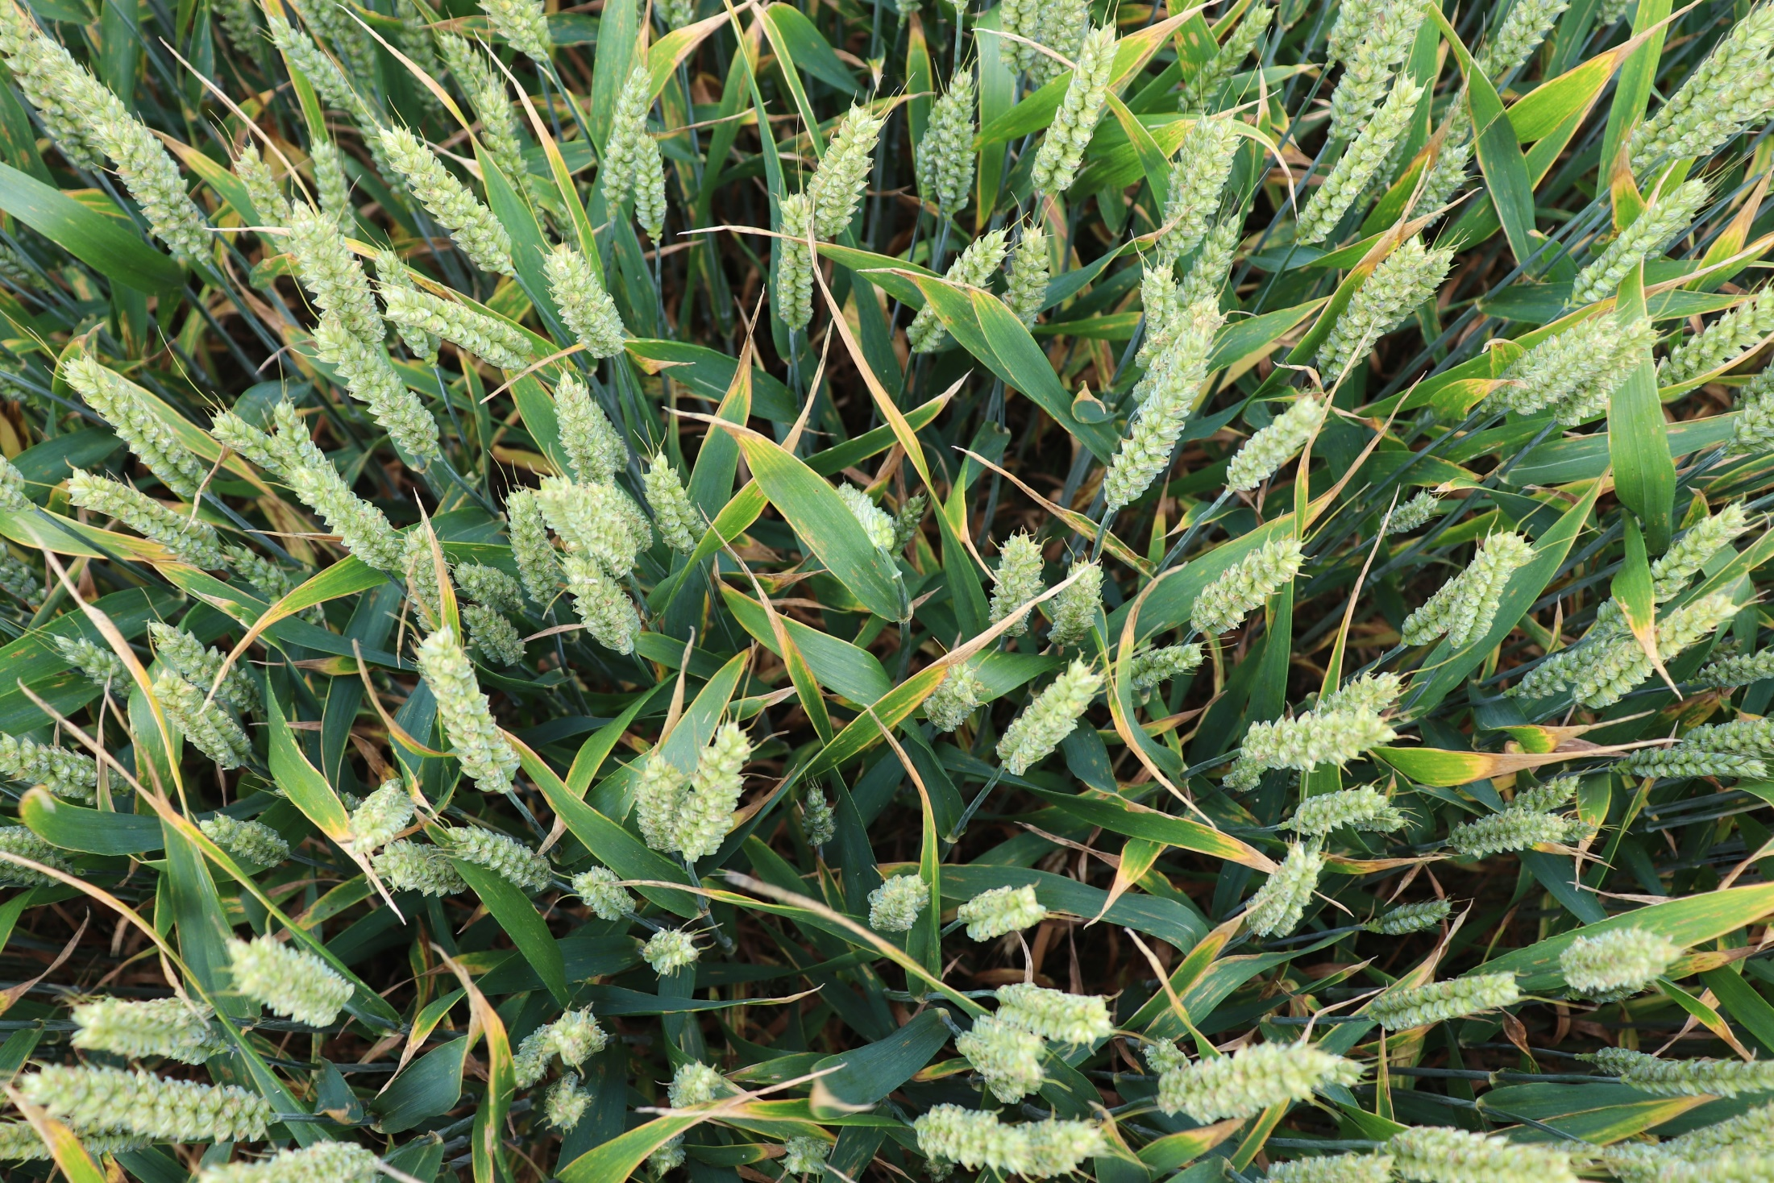
Farmers and advisers
Enabling farmers and advisers
Septoria leaf blotch (Zymoseptoria tritici)
Healthy crop
Healthy and diseased plots in a field trial, Herefordshire, June 2019

Slide 17
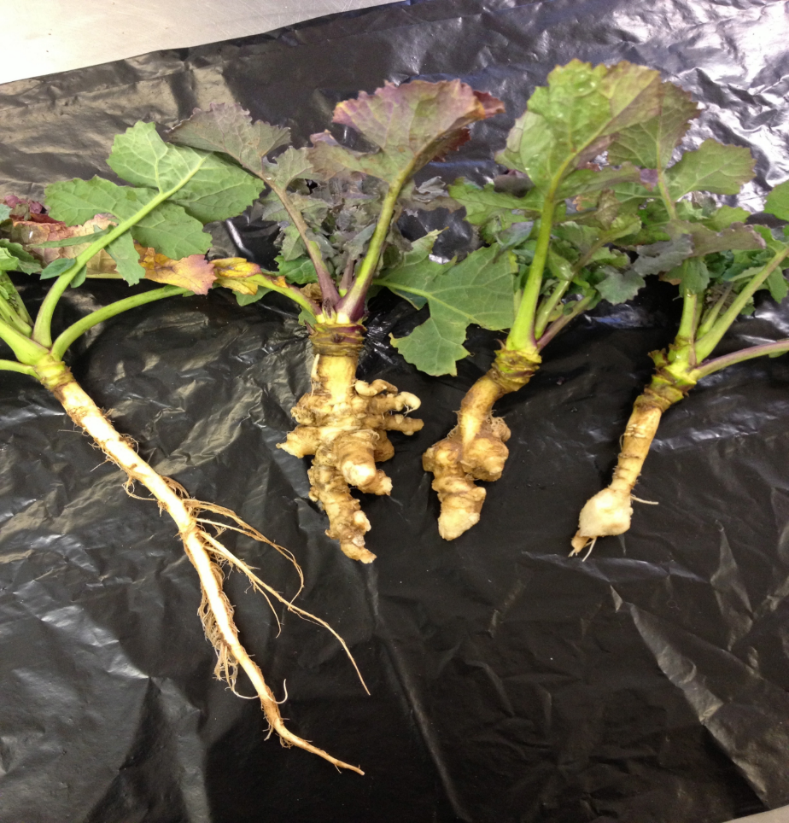
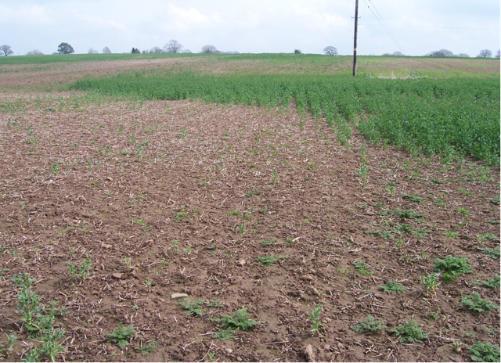
Supporting industry
Resistant variety
Susceptible variety
Clubroot infested fields in Shropshire, 2016

Slide 18
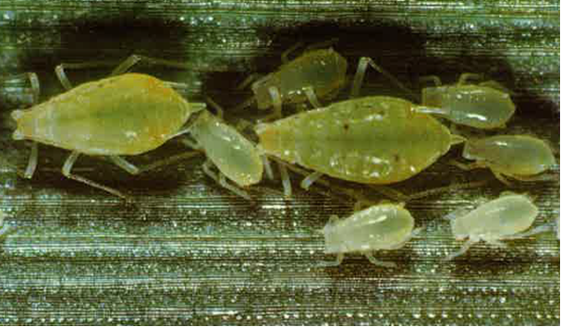
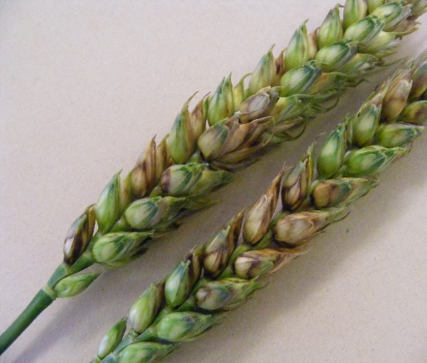
Supplying research
Survey data sets and pathogen resources recently made available
Pathogen isolates provided for:
Resistance monitoring studies
Plant breeder screening trials
Agrochemical company product development trials
PhD studentships
Data sets provided for:
Developing disease risk forecasting models & decision support tools
Regional risk maps for advisory services
Epidemiology studies
Scenario modelling of climate change impacts
Evaluation of IPM strategies and agronomy interventions

Slide 19
Defra (and wider) policy relevance
Plant Health & Biosecurity
UK Plant Biosecurity Strategy (2023–2028)
Plant Health Research and Development Plan (2023–2028)
UK International Action Plan for Plant Health
Pesticide regulation and IPM
UK Pesticides National Action Plan (NAP) 2025
Catchment Sensitive Farming (CSF)
Environmental Improvement Plan
UK Food Security Strategy, assimilated Regulation (EC) No 1107/2009
Plant Protection Products (Sustainable Use) Regulations 2012

Slide 20
Defra (and wider) policy relevance
Food security & sustainable farming
Environmental Improvement Plan (2025)
Sustainable Farming Incentive (SFI) & Environmental Land Management Schemes (ELMs)
UK Food Security and Supply Resilience Strategy
Climate adaption
UK Climate Change Framework (including Climate Change Act)
National Adaptation Programme
Defra Open Data Strategy and Evidence Action plans
R&D strategy teams
Genetic Improvement Networks
Defra Science Strategy
Crop improvement networks & AHDB

Slide 21
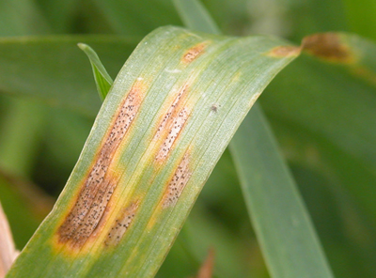
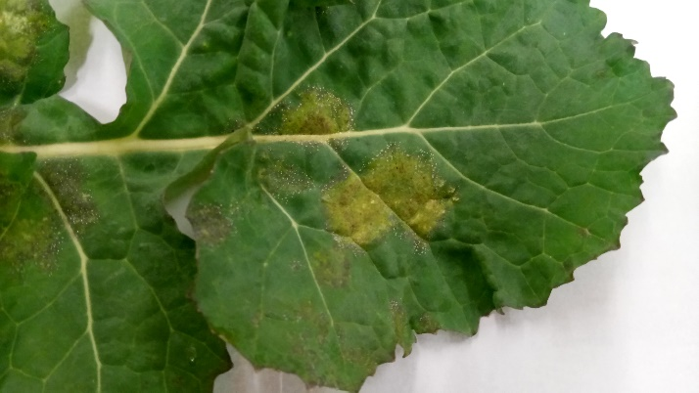
Brief methodology
250-300 wheat fields & 85-100 oilseed rape fields surveyed
Crops sampled at defined physiological growth stages
25 plants assessed from a traverse across the field
All diseases assessed, by individual plant part
Data reported as:
Crop incidence – the proportion of crops affected by a disease e.g., septoria was found in 90% of surveyed crops
Plant incidence – the proportion of affected plants within a crop e.g., 52% of plants within the crop had septoria
Severity – the proportion of plant part affected by disease e.g., the flag leaf had 10% septoria

Slide 22
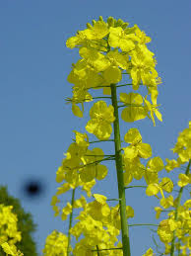
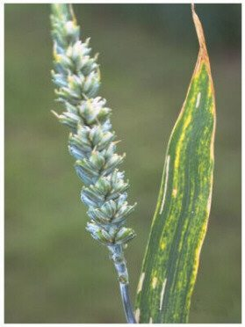
What data are available?
Oilseed rape: 1982 - present
Aphids
Natural enemies
Pollen beetle
Seed weevil
Stem weevil
TuYV
Diseases
Aphids
Natural enemies
CSFB
Diseases CSFB
Diseases
Oct | Nov | Dec | Jan | Feb | Mar | Apr | May | Jun | Jul | Aug | Sept
Wheat: 1970 - present
Diseases
BYDV
Lodging
Blackgrass

Slide 23
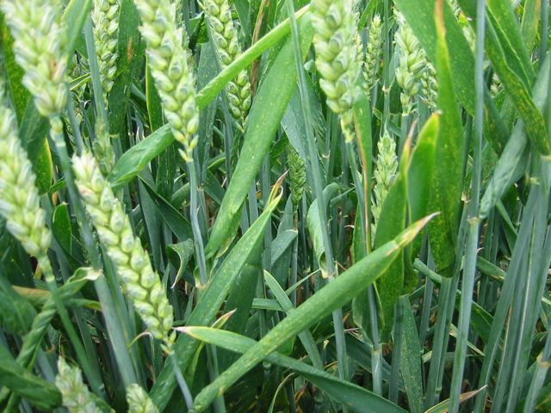
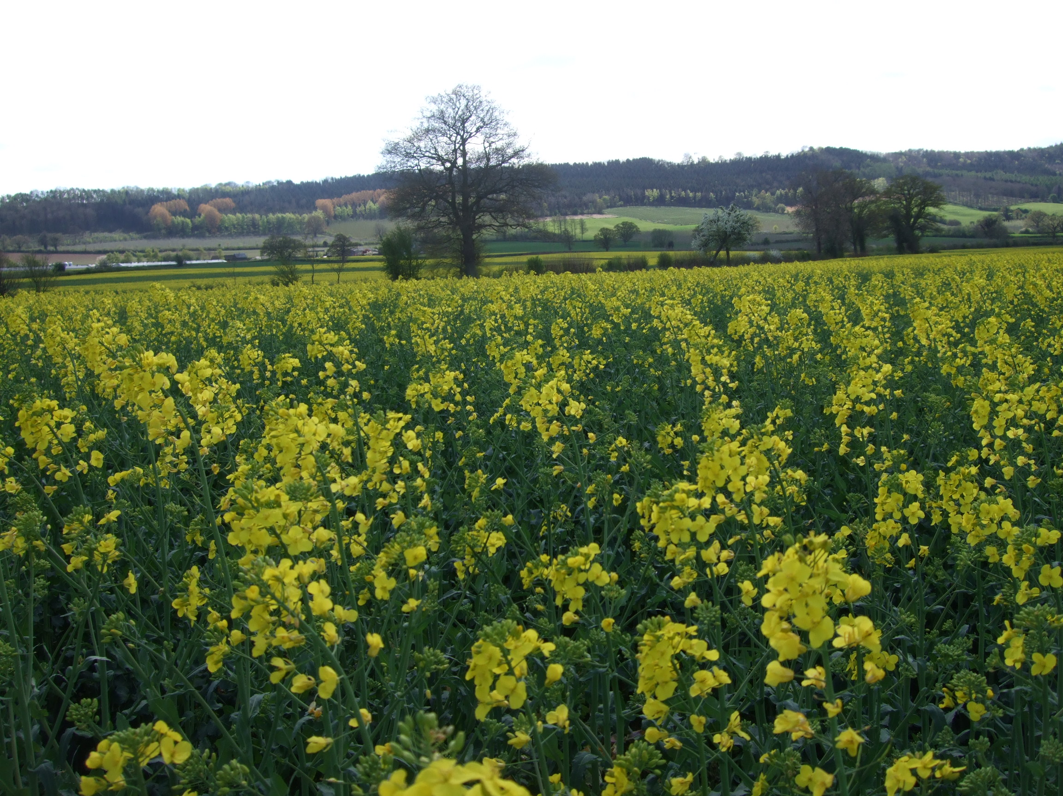
Agronomic information to accompany field observations
Field location (precise location is never disclosed)
Area of field
Variety & sowing date
Previous cropping (4 years)
Handling of previous crop debris
Field cultivation techniques
Seed origin (farm saved or certified)
All pre and post emergence pesticide inputs:
Product
Dose
Application date and/or crop growth stage

Slide 24
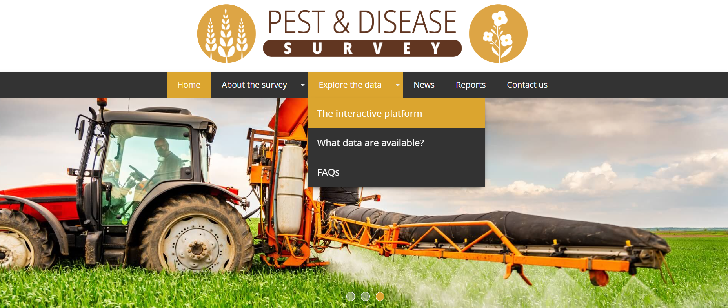
How do I access the data?
www.pestanddiseasesurvey.co.uk

Slide 25
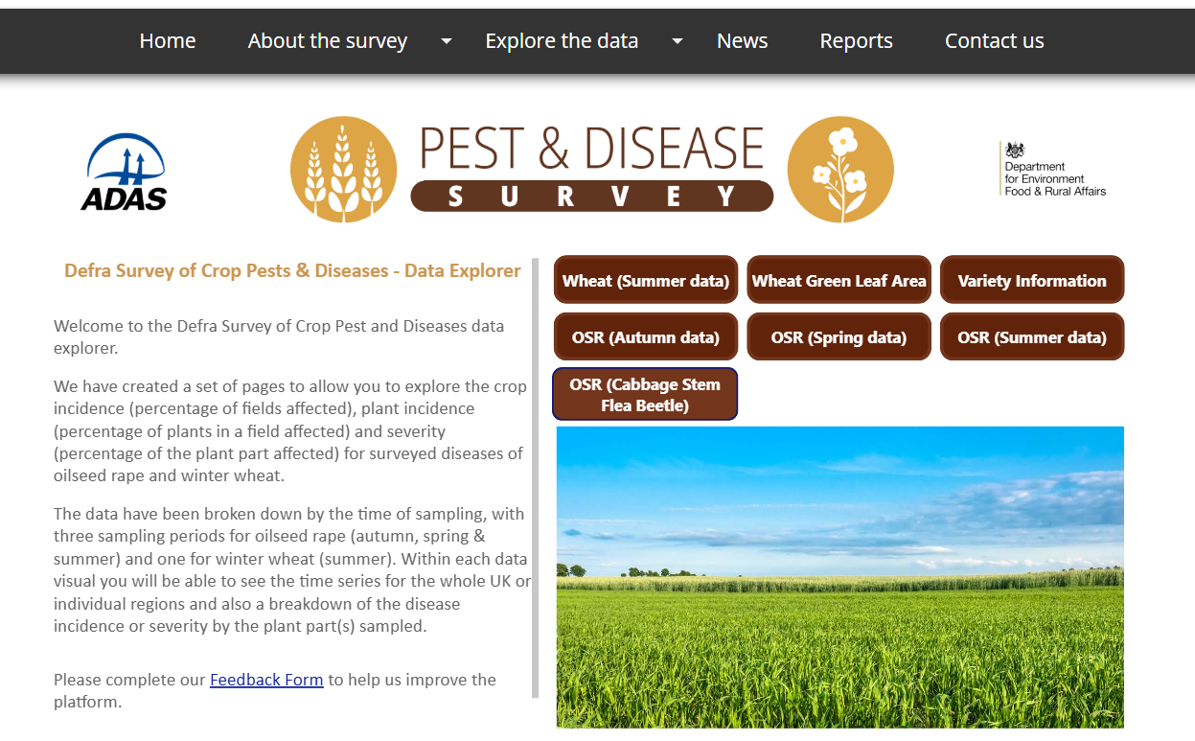
Interactive platform

Slide 26
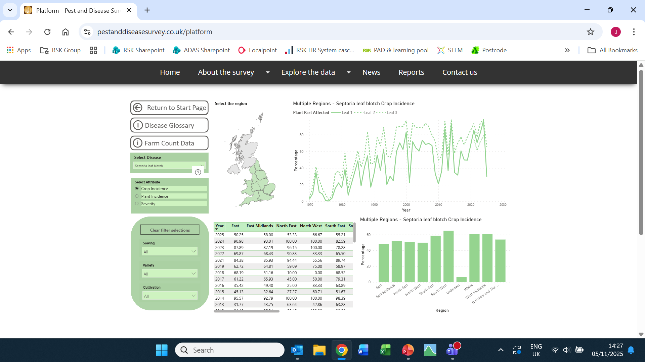
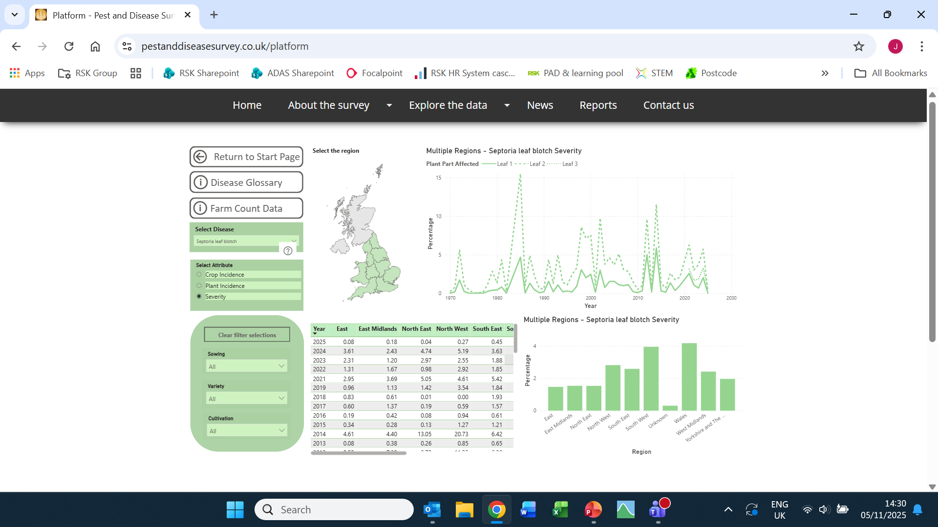
Interactive platform: wheat (1970 – present)

Slide 27
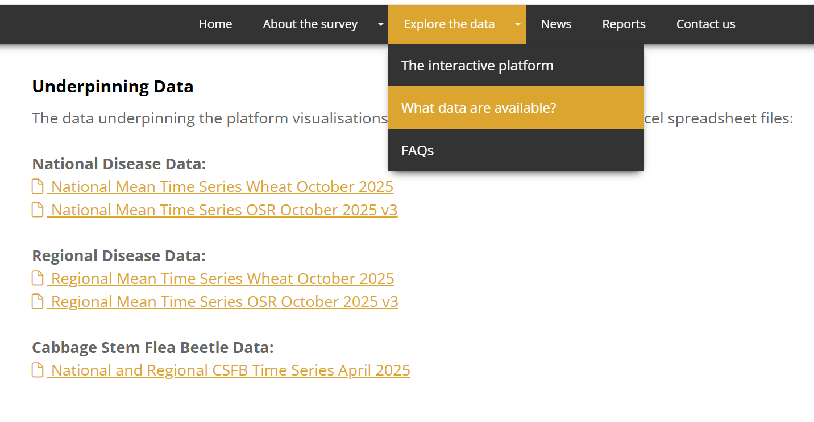
Download the data

Slide 28
Our analysis of the data so far
What determines disease severity in commercial fields?
Cultivar resistance, fungicide programme, sowing date, weather, previous crop, sampling data/sampling growth stage, seed origin
Cultivar resistance rating
Is resistance rating correlated with disease severity in the field?
Do growers select cultivars on basis of resistance rating?
Do growers adjust their fungicide programme according to the resistance rating?
Fungicide use
Do growers adjust treatment programmes when fungicide resistance develops?
Van den Bosch et al., (2025); Sims et al., (2025); Helps et al., (2025)

Slide 29
Caveats (from Defra)
Only the mean national and/or regional data that are publicly available on the website can be used
Requests for higher resolution data will not be approved for this competition
Contestants recognise that the data are being used in hypothetical scenarios to test a model(s) for an exercise which does not necessarily represent real life
Any planned outputs such as publications or articles must be authorised by Defra prior to publication
Defra must be acknowledged in outputs and KE activities

Slide 30
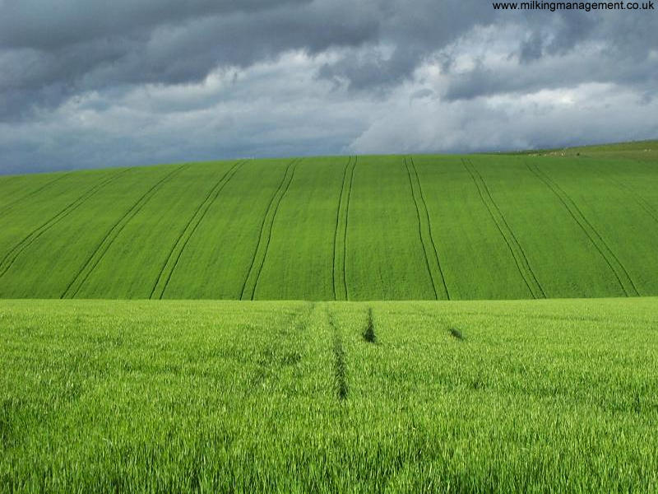
Thank you
pestanddiseasesurvey@adas.co.uk
www.pestanddiseasesurvey.co.uk
@DefraSurvey

Slide 31
Coffee Break
Refreshments are around the corner in the kitchen areas

Slide 32
Forecasting Severe System Pressure in the NHS

Slide 33
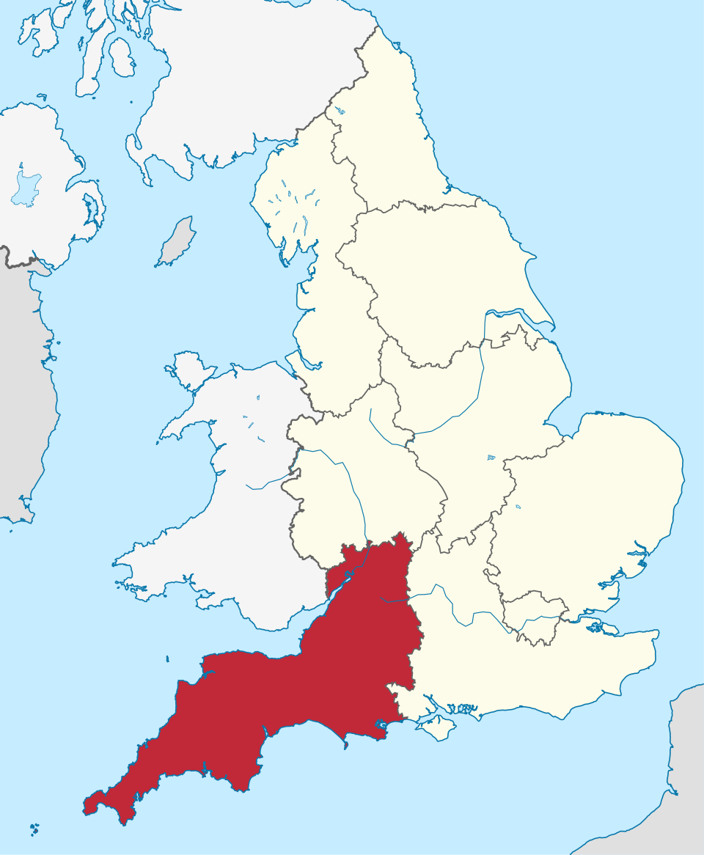

Introduction
Hospitals, EDs, and ambulances face unpredictable surges that risk patient care
Predicting severe system pressure enables proactive staffing, resource allocation, and patient flow management

Slide 34
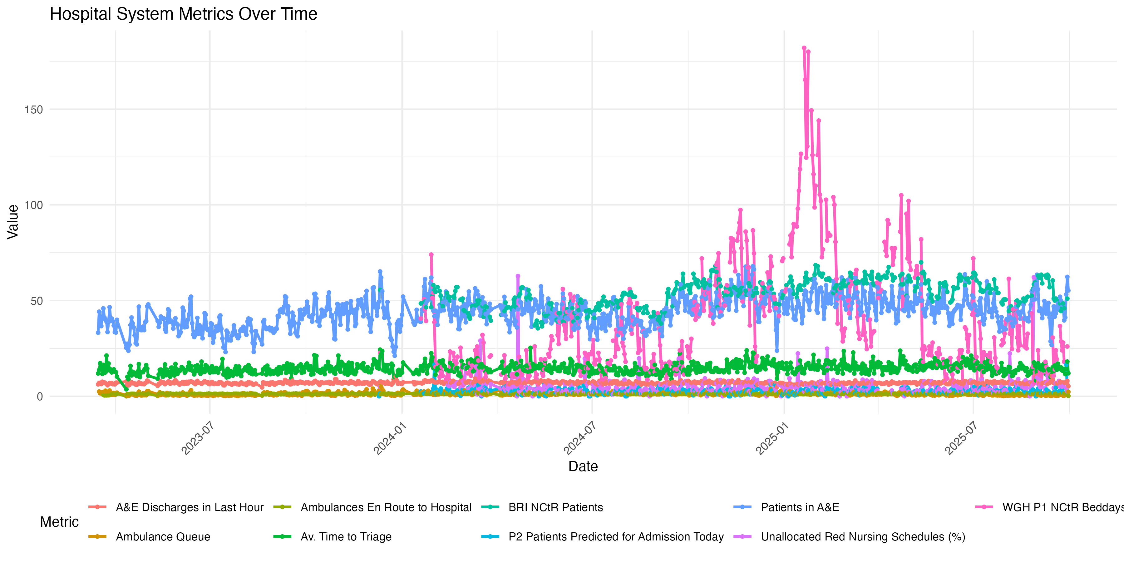
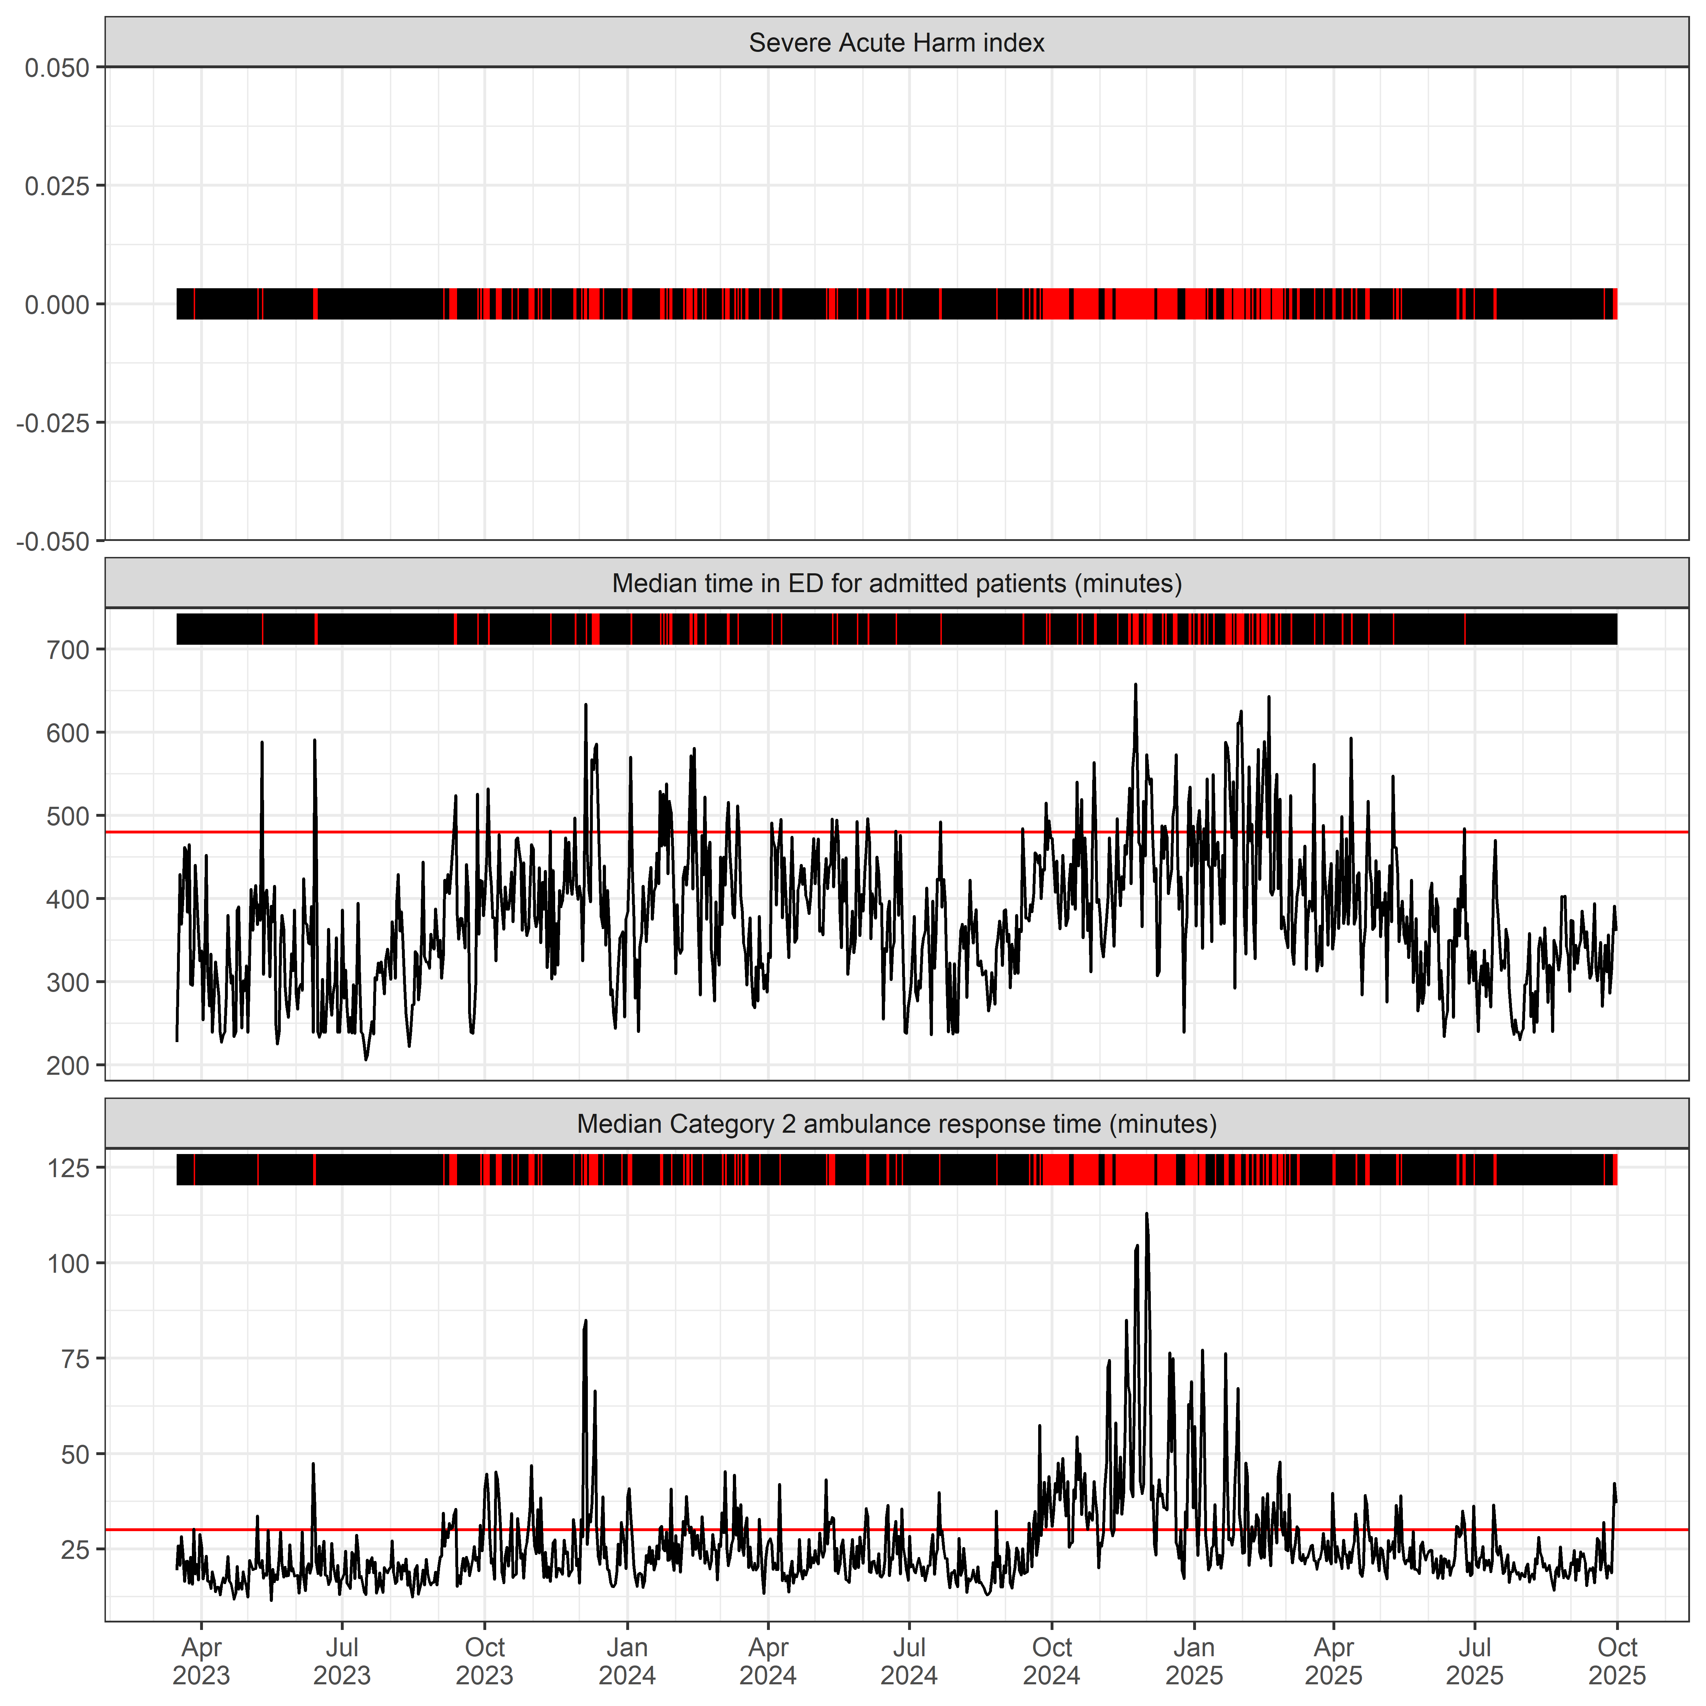
Data
Predictors:
157 variables
Hospital, ambulance, ED, primary care
Outcome variable: Severe System Pressure
Binary variable
ED time + cat 2 ambulance response time
2.5 years of data (Mar 2023 – Sep 2025)
15 min – 24 hr temporal resolution

Slide 35
Contest
Goal: build an AI forecasting pipeline to predict severe system pressure at 1-10 day horizons
Prize 1: use provided feature dataset
Prize 2: can include additional data
Repo and data now public via SPHERE Github
Watch this space
Load & Merge data
Preprocessing & Feature engineering
Skewness transformation
Time series split
Feature scaling & selection
Model training – Elastic Net Regression
Multiple Horizon Forecasting

Slide 36
Activity 1 - Identifying Key Environmental Challenges

Slide 37
How its going to work!
https://shorturl.at/rtEzv
Stage 1 - Break-out Discussions (45 minutes)
Split into teams
45 minutes to talk about key environmental challenges that relate to modelling & forecasting
Add them to the Mural Board
Don't worry about finding solutions, we will do that in this afternoon's session
Stage 2 - Group Feedback & Contest Priorities Vote (45 minutes)
Each team will have 2 minutes to present what they think is the biggest challenge they discussed
These will form the basis of our forecast contest discussions later!

Slide 38
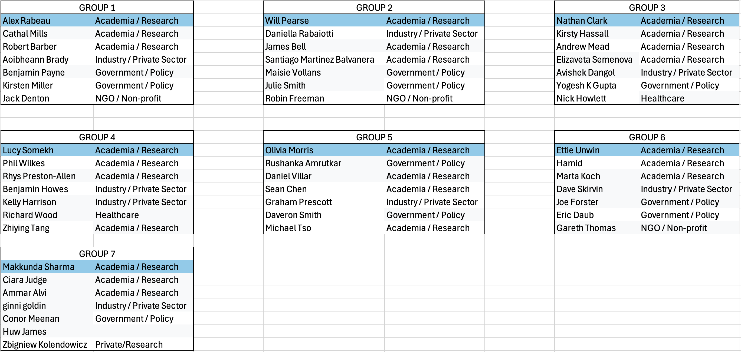
Groups
https://shorturl.at/rtEzv

Slide 39
Activity 1 – Group Feedback

Slide 40
Lunch Break
Refreshments and food are around the corner in the kitchen areas!

Slide 41
Welcome Back!
Timings | Activity | Description
13:50-14:00 | Lyme Disease Contest Prize Giving
14:00-14:10 | Presentation - Will Pearse | Building a Forecasting Contest
14:10-14:45 | Break-Out Design | Activity 2 - Groups design forecasting contests
14:45-15:15 | Break-Out Feedback | Group feedback and discussion of contest priorities
15:15-15:40 | Coffee Break
15:40-16:05 | Keynote 3 - Eric Daub | The Alan Turing Institute
16:05-16:15 | Presentation - Will Pearse | What can SPHERE-PPL do for you?
16:15-16:35 | Break-Out Discussion | Activity 3 - Brainstorming requests for workshops, training and support
16:35-16:55 | Break-Out Feedback | Creating a community priority list
16:55-17:00 | Wrap-Up

Slide 42
Lyme Disease Contest Prize Giving

Slide 43
Activity 2 – Designing a Forecasting Contest

Slide 44
How its going to work!
Stage 1 – Building a Forecasting Contest (10 minutes)
Quick presentation from the SPHERE-PPL team on how the forecasting contests are going to work mechanically and what makes a good contest
Stage 2 – Break-Out Discussions (40 minutes)
Split into teams aligned to the identified key challenges.
Using the Contest grids on the Mural Board, start designing a forecasting contest
Stage 3 - Group Feedback (40 minutes)
Each team will give an overview of their proposed contest
Indicative vote on what would provide greatest impact

Slide 45
Building a Forecasting Contest
From Questions to Insights
Dr Will Pearse

Slide 46

Why do a Forecasting Contest?
Grand Vision
An open-source and globally-accessible competition to find innovative and accurate ways of predicting something.
A conduit for connecting stakeholders with analytical capability.
Smaller Scale
Find answers to the challenges we talked about earlier!
Put resources and insights into your hands.

Slide 47
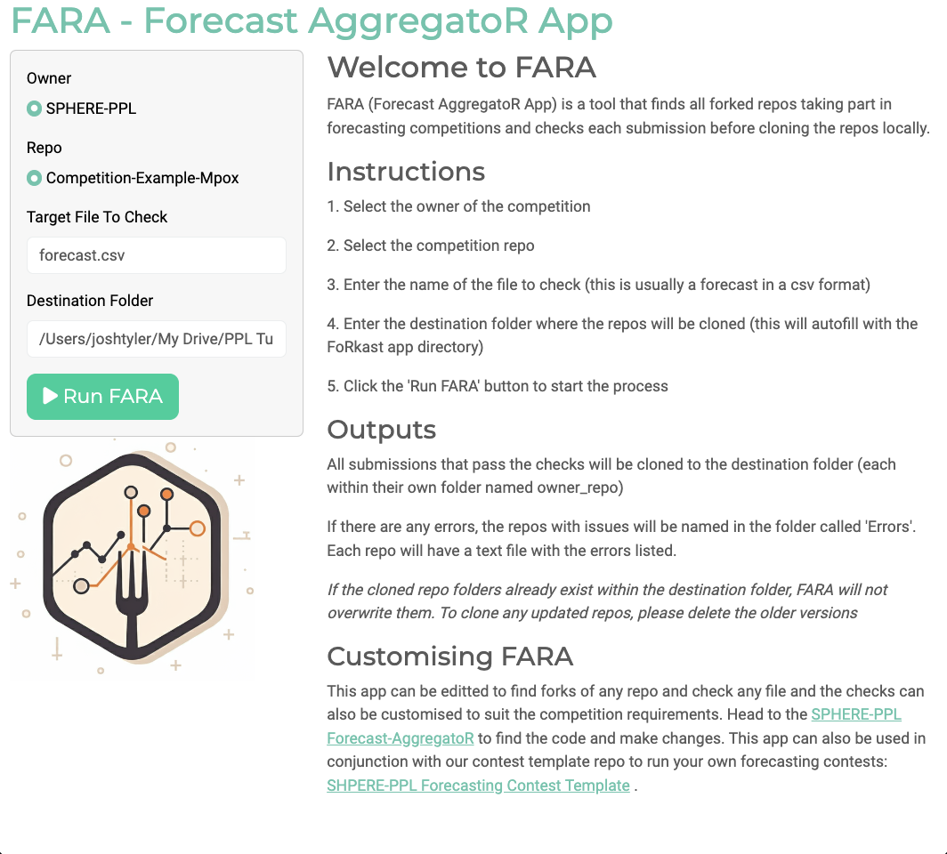
SPHERE-PPL Framework
A Github Repo, that can be cloned, edited and then collated by contest organisers, using our Forecasting AggregatoR App (FARA).
FARA can:
Find all contest submissions automatically
Check entries for errors and issues
Be customised for any GitHub-based contest
Condense all results and synthesise insights

Slide 48
Journey of a Contest
Design
Implementation
Participation
Aggregation
Insights

Slide 49
Considerations
Design What are the Key Challenges we want to solve?
Who will benefit from the forecasts?
Implementation What datasets can we use openly? Are there any specific strategies or tools that we want to see?
Participation Can we engage with a diverse set of teams? Do they have enough time? How can we best support them?
Aggregation How should we aggregate all the entries? Do we want to build a new model based on the findings of the contest?
Insights What format would create the most impact? How can we disseminate the results and maximise usefulness?

Slide 50
Maximising Value to Stakeholders
Forecasting Contests
New Tools & Techniques
Novel Insights
Growth & Improvement
New Questions

Slide 51

Example - CVDs
Key Challenge | Future burden of Cardiovascular Disease (CVD)
Exam Question | Forecast the number of new cases of CVD in the UK for each year from 2024 to 2034, stratified by age group and sex.
Usable Data | PHE Data (Trends in CVD mortality, morbidity, and risk factors ONS Data (population projections, mortality rate, socioeconomic factors)
Output Format | Table of forecasted numbers Summary report Deployable app
Other Information | Include coronary heart disease, stroke, and heart failure

Slide 52
How its going to work!
https://shorturl.at/1ahdl
Stage 1 – Building a Forecasting Contest (10 minutes)
Quick presentation from the SPHERE-PPL team on how the forecasting contests are going to work mechanically and what makes a good contest
Stage 2 – Break-Out Discussions (40 minutes)
Split into teams aligned to the identified key challenges.
Using the Contest grids on the Mural Board, start designing a forecasting contest
Stage 3 - Group Feedback (40 minutes)
Each team will give an overview of their proposed contest
Indicative vote on what would provide greatest impact

Slide 53
Key Environmental Challenges

Slide 54
Activity 2 – Group Feedback

Slide 55
Coffee Break
Refreshments are around the corner in the kitchen areas

Slide 56
Keynotes

Slide 57

Keynotes
 | Dr Eric Daub – The Alan Turing Institute

Slide 58
Activity 3 – Building a Community

Slide 59
How its going to work!
Stage 1 – What can SPHERE-PPL do for you? (10 minutes)
Quick presentation from the SPHERE-PPL team on what the future holds
Stage 2 – Brainstorming requests for workshops, training and support (20 minutes)
Split into groups and make a list of different ideas that would help you make progress in your area (added on the Mural Board)
Include as many details as possible!
Stage 3 – Creating a community priority list (30 minutes)
Each team will give an overview of their requests
Discussion around how the SPHERE-PPL community can best facilitate and maximise value

Slide 60
What can SPHERE-PPL do for you?
The network’s primary goal is to connect data-scientists, researchers and policy-makers, to enable high-quality modelling and data-driven decision-making.
The SPHERE-PPL project has funding to facilitate workshops, training and targeted support on both fundamental modelling & probabilistic programming, alongside events and sessions like today, working directly with stakeholders.

Slide 61
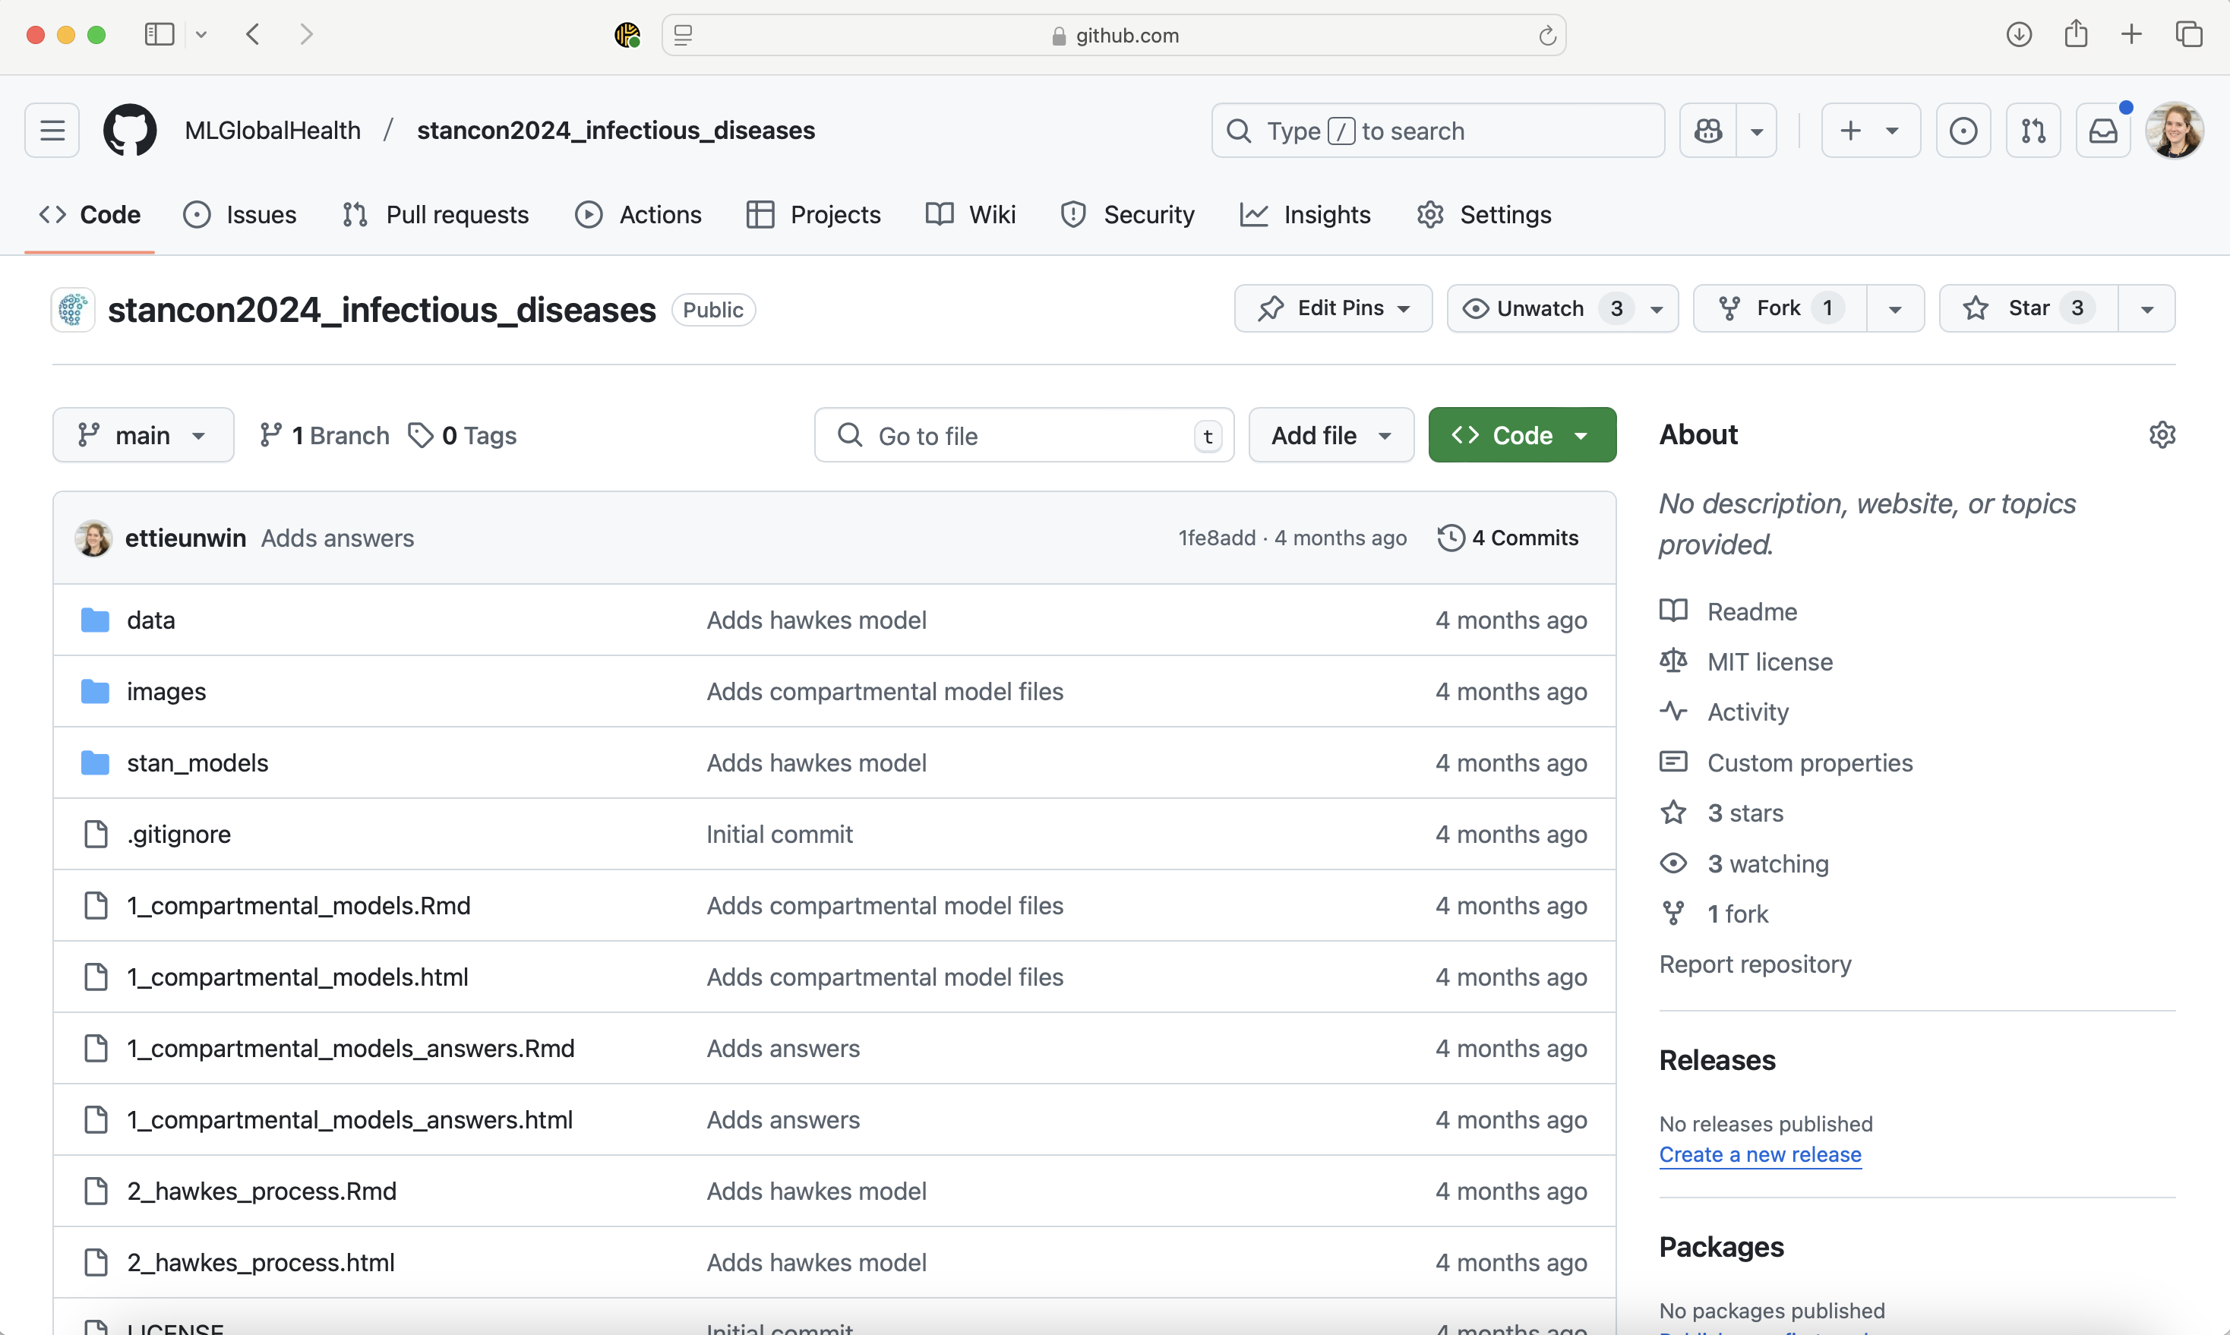
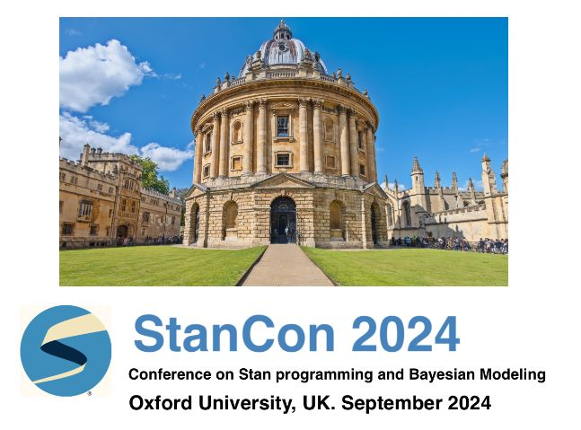
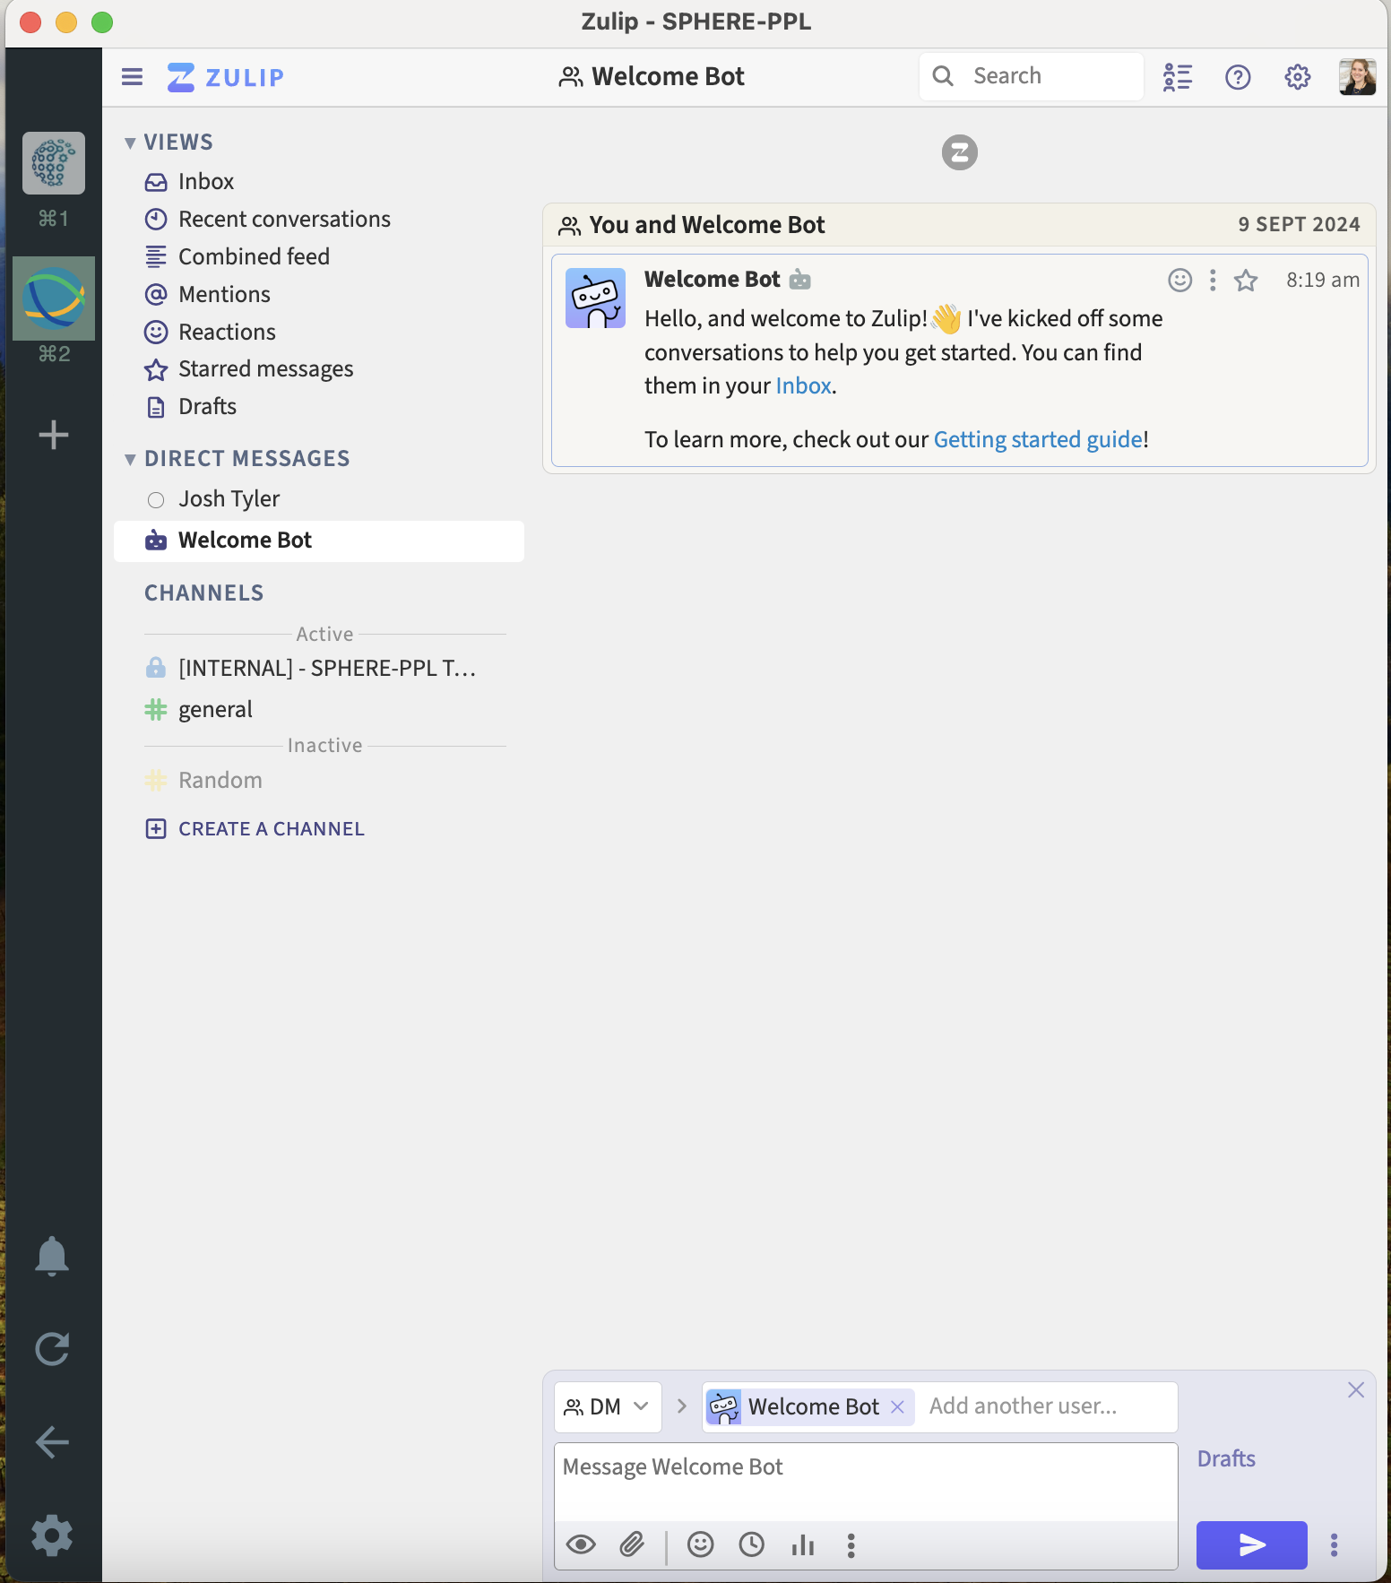
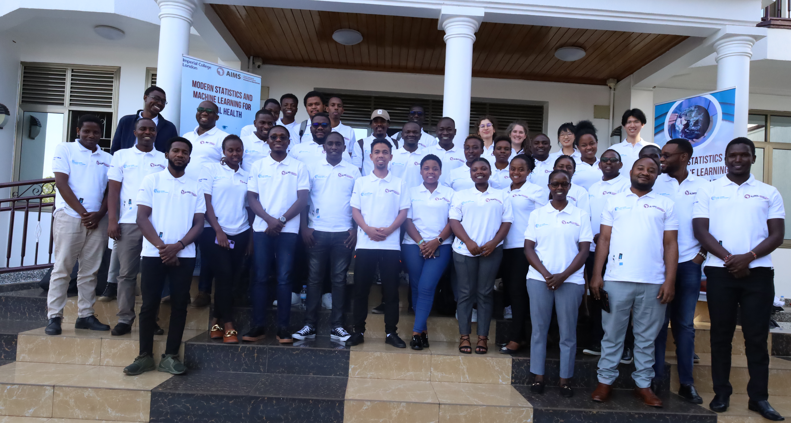



What we’ve done so far

Slide 62
How its going to work!
https://shorturl.at/SxCEd
Stage 1 – What can SPHERE-PPL do for you? (10 minutes)
Quick presentation from the SPHERE-PPL team on what the future holds
Stage 2 – Brainstorming requests for workshops, training and support (20 minutes)
Split into groups and make a list of different ideas that would help you make progress in your area (added on the Mural Board)
Include as many details as possible!
Stage 3 – Creating a community priority list (30 minutes)
Each team will give an overview of their requests
Discussion around how the SPHERE-PPL community can best facilitate and maximise value

Slide 63
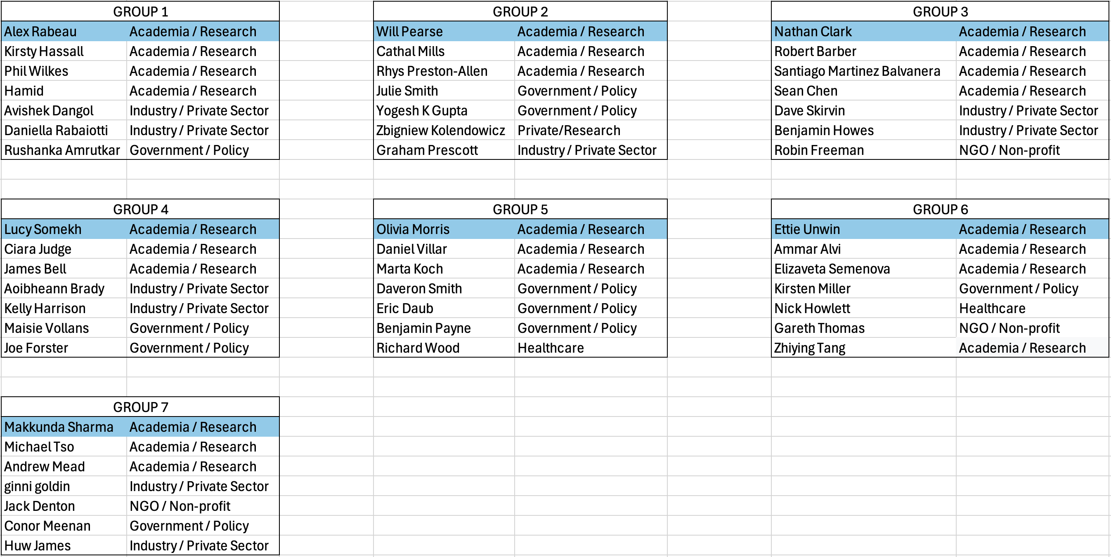
Groups
https://shorturl.at/rtEzv

Slide 64
Activity 3 – Priority List

Slide 65

Wrap-Up
We’ve reached the end of the day!
Please complete the Feedback Survey!
We’re now heading to the Queen’s Head pub, 66 Acton St!

Slide 66
Thank-You!
For more information, please visit www.sphere-ppl.org or email the team at info@sphere-ppl.org.

